Slide 1

Dr. B. R. Ambedkar University, Srikakulam
Department Of Computer Science And Engineering
CODE SENSE -
AI DRIVEN ASSESMENT TOOL FOR CODE COMPREHENSION
Name of Project Guide
Dr. G. Rama Krishna
(Professor, CSE)
by
P. SAI VENKATESH PRABHU 2181951065
CH. NOOKA VENKATA PRAVEEN 2181951058
R. SAKETH KUMAR 2181951069
G. SAHITHI PRASANNA 2181951062
P. SUDHA KEERTHI 2181951066
R. LAVANYA 21819510685

Slide 2
INDEX
ABSTRACT
INTRODUCTION
EXISTING SYSTEM
DRAWBACKS OF EXISTING SYSTEM
PROPOSED SYSTEM
BLOCK DIAGRAM
HARDWARE AND SOFTWARE REQUIREMENTS
ALGORITHM
RESULTS
CONCLUSION

Slide 3
ABSTRACT
In computer science education, verifying a student's understanding of code is crucial yet challenging, especially in lab settings where assessments often rely on outputs without insight into the student’s comprehension.
This project aims to develop an AI-driven assessment tool designed to evaluate students’ understanding of their code submissions.
By integrating generative AI, the tool will dynamically create customized questions based on the submitted code, prompting students to explain logic, predict outcomes of code modifications, and address related theoretical concepts.
Using generative AI models, the tool analyzes code to generate context-specific follow-up questions that are tailored to each student's submission. These questions assess not only the correctness of the code but also the depth of the student's conceptual understanding, distinguishing between rote memorization and true comprehension
Responses are automatically evaluated, with scores contributing to lab or viva assessments, allowing educators a more accurate and efficient means of grading.

Slide 4
INTRODUCTION
In the realm of computer science education, assessing a student's true understanding of programming concepts is a complex task, often limited by traditional methods that focus solely on code outputs. To bridge this gap, our project introduces an AI-driven assessment tool designed to evaluate students' comprehension of their code submissions dynamically. This tool leverages generative AI to create customized questions based on the submitted code, prompting students to explain their logic, predict outcomes of code modifications, and address related theoretical concepts. By integrating this tool into lab settings, educators can gain deeper insights into students' understanding, moving beyond mere code correctness to assess conceptual mastery

Slide 5
EXISTING SYSTEM
There are AI quiz generators which generates the question based on the data.
Manual evaluation of lab assessments and code understanding of the concepts and the programs
Code review and generation models like github copilot, chatgpt are available to public to get the relevant knowledge.
AI-Based Automate assessment tool in king's college london using the Code BERT model for code Quality and grading the students.
Coding platforms like hacker rank can be used to test the lab assessments and write the code.

Slide 6
DRAWBACKS OF EXISTING SYSTEM
There are drawbacks regarding this existing system which won’t allow users to fulfill
their needs. Some of the major issues regarding the system are as follows:-
Generic Questions: Lack of context-specific or personalized questions.
Limited Customization: Rigid formats and non-adaptive difficulty levels.
Theory-Focused: Poor at assessing practical skills, especially programming.
Encourages Memorization: No validation of deep understanding or thought process.
No Coding Integration: Cannot evaluate or interact with actual code.
Static Evaluations: No real-time feedback or dynamic adjustments during quizzes.
Limited Analytics: Basic scoring with no insights into learning gaps or code quality.

Slide 7
PROPOSED SYSTEM WITH ADVANTAGES
The proposed solution is a web based platform that allows the students to submit their code and the LLM will dynamically generate the tailored questions based on the question and code submitted.
Verifies Genuine Understanding: Ensures students grasp the concepts rather than relying on memorization or copying.
Personalized Assessment: Tailors questions dynamically to each student’s solution, promoting deeper learning.
Immediate Feedback: Provides instant results, enabling students to identify and address knowledge gaps.
Automated Viva: Combining coding and conceptual understanding in a seamless workflow improves the evaluation process.

Slide 8
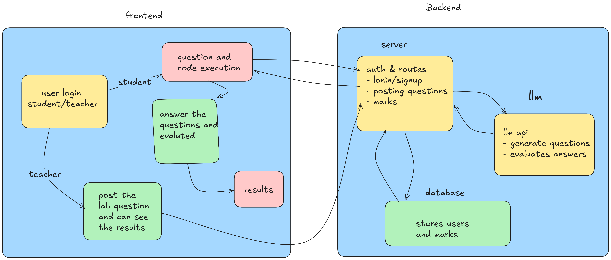
BLOCK DIAGRAM

Slide 9
HARDWARE AND SOFTWARE REQUIREMENTS
Hardware Requirements:
Server: Multi-core processor, 16 GB+ RAM, SSD storage, high-speed internet (1 Gbps).
User Devices: Dual-core processor, 4 GB RAM, modern browser, stable internet.
Software Requirements:
Frontend: React.js/Angular, Monaco Editor/CodeMirror for in-browser IDE.
Backend: Python/Node.js, Django/Express.js, Judge0 API/Docker for code execution.
Database: MySQL/PostgreSQL for structured data, MongoDB for AI-related data.
AI Models: OpenAI API, TensorFlow/PyTorch for question generation.
Deployment: Cloud services (AWS/Azure), Docker for scalability.
Testing: Postman (API), Selenium (UI).

Slide 10
ALGORITHM
. User Authentication:
Verify user credentials (student/teacher) during login.
Grant role-based access to features (e.g., students can submit code, teachers can post assignments).
Code Submission and Feedback:
Allow students to submit code for assignments.
Use AI to evaluate the code and generate feedback and display feedback to students.
Quiz Generation and Evaluation:
Automatically generate quizzes based on the submitted code.
Evaluate student answers to quizzes using AI and display quiz results.
Assignment Management and Monitoring:
Enable teachers to create and post lab assignments.
Monitor student submissions and evaluate them.
Assign marks and track student progress in real-time.
:

Slide 11
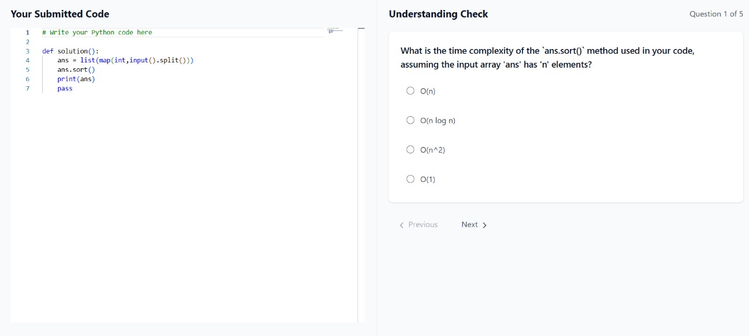
RESULTS
Student login contains of only 2 parts which are writing the code and submitting it and then attempting the quiz and submitting the assessment.

Slide 12
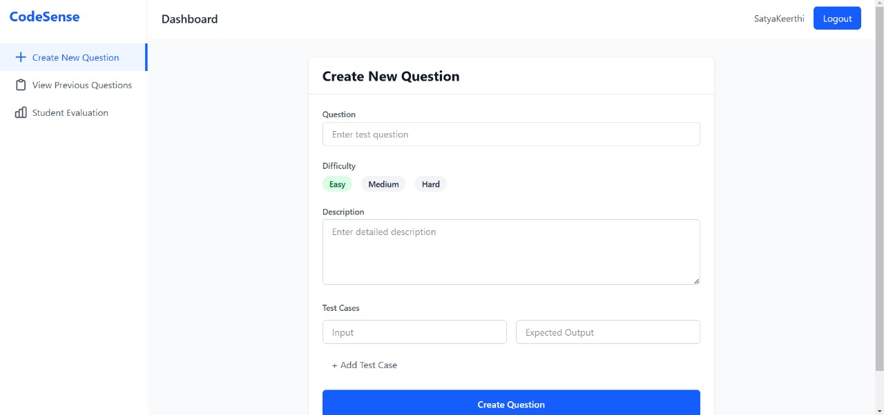
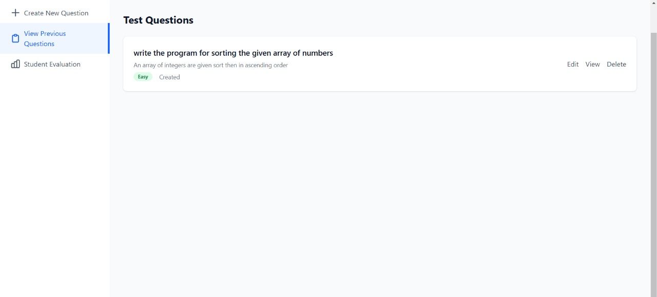
RESULTS
Teacher login has mainly 3 parts which are question creation ,view the generated test questions and also the assessment evaluation. The marks will be awarded by the teacher by the student performance.
Fig : Satellite Image
Fig : Optimal Path

Slide 13
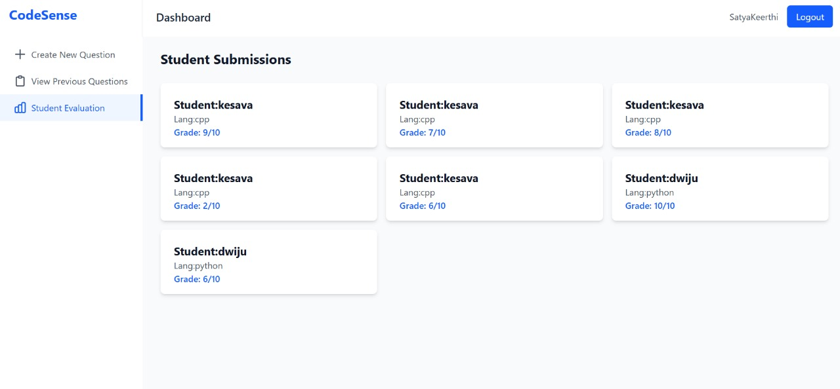
RESULTS
Fig : Land Cover

Slide 14
CONCLUSION
In conclusion, our project addresses critical gaps in traditional lab evaluations by combining practical coding assessments with AI-driven conceptual understanding. The platform ensures:
Holistic Evaluation: By integrating coding, dynamic AI-generated questions, and conceptual testing, students are assessed on practical skills and deeper knowledge.
Authenticity: The inclusion of plagiarism detection and tailored questions ensures genuine effort and understanding.
Efficiency: Automation simplifies the evaluation process for faculty, saving time while maintaining accuracy.
Innovation: The AI-powered question generator transforms static lab assessments into engaging and adaptive experiences.

Slide 15
THANK YOU

